Slide 1

Which Is Deeper Comparison of Deep Learning Frameworks On Spark
Office of the CTO - July 2016
Notes:
We have been using spark intensively in our security analytic project.
As deep learning is the hottest topic in recent several years, we wonder if we can apply deep learning into our security analytic project.
We have tried some deep learning on Spark frameworks and got some experience to share with everyone here.
So, today, my topic is “Which Is Deeper? Comparison of Deep Learning Frameworks on Spark”

Slide 2
Outline
Motivation
Theoretical Principle
State-of-the-Art
Evaluation Criteria
Evaluation Results
Summary
Conclusion

Slide 3
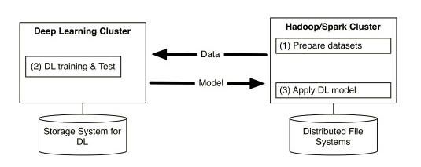
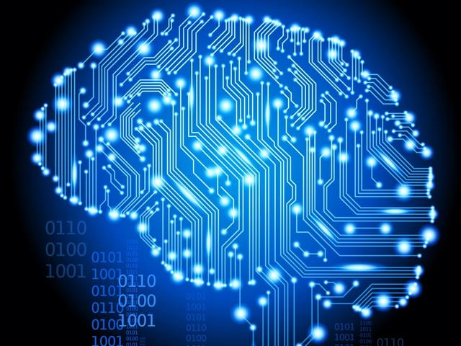
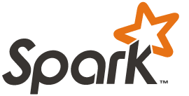
Deep Learning on Spark Motivation
Single-machine DL
Low efficiency (in hours to even days)
Limited DNN model capability (hard to support billions of parameters)
Dedicated deep learning cluster
Massive data movement
High maintenance cost
Spark+Deep Learning = Truly All-in-One
Notes:
Motivation. Let's see why industry wants to integrate these two technologies together.
For deep learning, most use cases are used in single-machine.
Obviously, single-machine deep learning has limitations. One is low efficiency. User has to train a complicated model in several hours to even several days even though GPU is enabled. Another limitation is limited deep learning NN model capability. It’s hard to support billions of parameters for single-machine. Most of deep learning work has focused on training relatively small models on a single machine. So we think distributed deep learning is a right direction. Google just released the distributed version Tensorflow in April. [Click]
The second motivation is there are several shortcomings for dedicated deep learning cluster. The first one is massive data movement. Look at this picture borrowed from CaffeOnSpark, there are two clusters. One is deep learning cluster, another is spark and hadoop cluster. Now we want to use deep learning cluster to analyze the data stored in spark cluster, we have to load data from spark cluster into deep learning cluster, after training and calculation, send huge model back to spark cluster. The massive data movement is high time-consuming and network-consuming. The second shortcoming is high cluster maintenance cost, it is quite obvious. [Click]
Based on the above reasons, industry started to combine deep learning and spark into an all-in-one solution. It could not only train complicated DNN model in a reasonable time, but also could let user use deep learning as same as using MLlib and GraphX without unnecessary data movement. It’s a truly all-in-one solution for comprehensive end-to-end big data analytics

Slide 4
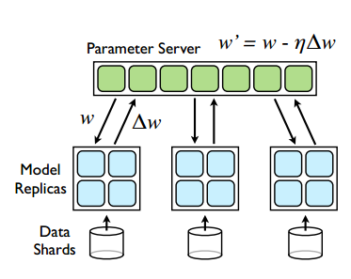
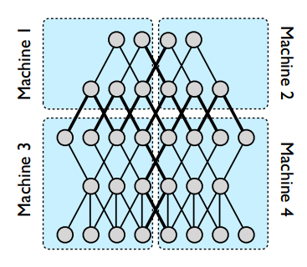
Theoretical Principle
Large Scale Distributed Deep Networks,Jeffrey Dean,2012
Model parallelism
Data parallelism
https://papers.nips.cc/paper/4687-large-scale-distributed-deep-networks.pdf
Notes:
Distributed deep learning is derived from paper of Jeff Dean in two thousand twelve.
It introduces two kinds of parallelism: model parallelism and data parallelism.
Model parallelism is very complicated. Look at the left picture, model is split into several parts, each worker only trains one part of model.
The main problem is how to synchronize the model’s different parts. It would be a very complicated process. Now no deep learning on Spark framework has implemented model parallelism.
The right figure is data parallelism, it’s relatively easier. Model will not be split.
Each worker will maintain a complete model.
Now all deep learning on Spark frameworks use data parallelism. So it’s necessary to highlight the data parallelism.

Slide 5
Data Parallelism for distributed SGD
Model is replicated on worker nodes
Two repeating steps
Train each model replica with mini-batches
Synchronize model parameters across cluster
Specific implementations can be different
How parameters are combined
Synchronization (strong or weak)
Parameter server (centralized or not)
Notes:
In data parallelism, model is replicated on worker node across cluster.
The training process just contains two repeating steps:
the first step is to train each model replica with mini-batches in spark’s executor.
Mini-batch is an iteration to train subset of data.
The second step is to synchronize model parameters across cluster.
The step is quite straightforward but specific implementation could be different in following three aspects:
First difference is how parameters are combined.
User can just average the parameters or do some complicated math calculation.
Second difference is synchronization extent. There is an implementation in Jeff Dean’s paper, it’s called downpour SGD and its synchronization extent is weak which means in its implementation, fetching parameters and updating parameters is asynchronous with training process on a mini-batch.
The third difference is architecture of parameter server. Most implementation of distributed deep learning use centralized parameter server. It dedicate for fetching parameters and updating parameters.
Another kind of architecture is peer-to-peer, decentralized parameter server. This kind of parameter server will be distributed on each worker node.

Slide 6
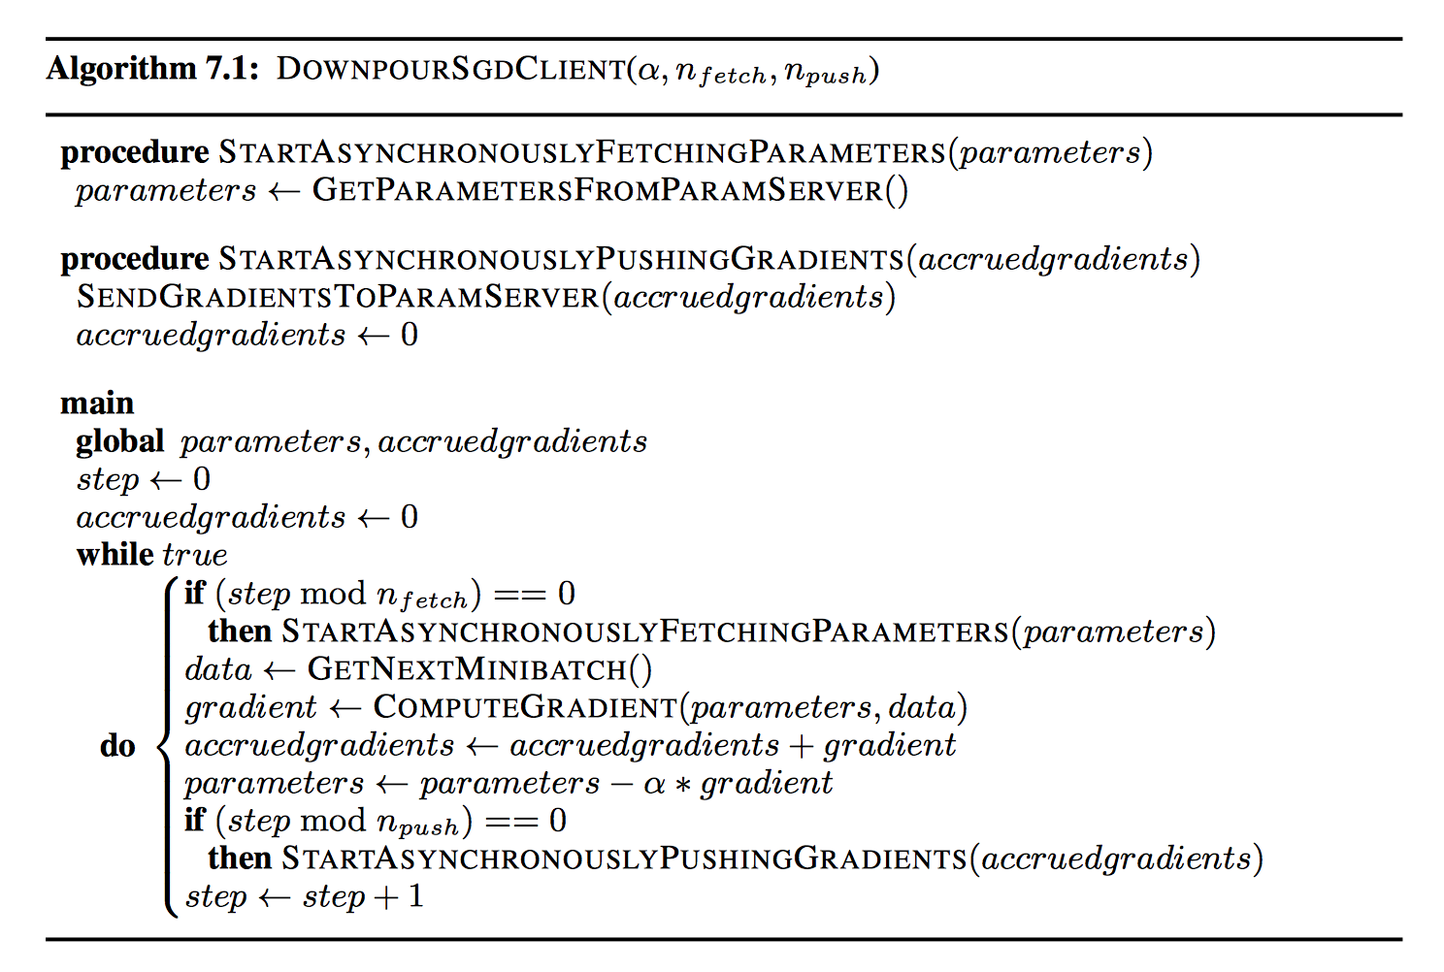
DownpourSGD Client Pseudo code
http://www.cs.toronto.edu/~ranzato/publications/DistBeliefNIPS2012_withAppendix.pdf

Slide 7
DL on Spark – State-of-the-Art
AMPLab SparkNet
Yahoo! CaffeOnSpark
Arimo Tensorflow On Spark
Skymind DeepLearning4J
Baidu Paddle
DeepDist
H2O Sparkling Water
Which is deeper?
Notes:
Here I listed most of mainstream deep learning on Spark framework.
Today we will just focus on the top four frameworks as the time limitation.
Who are these participants and how about their products? [Click]
Now let’s start to look at these deep learning on spark frameworks one by one and make the choice - which is deeper?

Slide 8
Evaluation Criteria
Evaluation Criteria | Dimensions | For Example
Ease of Getting Started | Documentation | Are there detailed, well-organized, up-to-date documents?
 | Installation | How automatic it is?
 | Built-in Examples | Examples available for quick warming up?
Ease of Use | Interface | Programming language support
 | Model Encapsulation | Model/Layer/Node
Functionality | Built-in Models | Which NN models have been implemented?
 | Parallelism | Model parallelism or data parallelism
Performance | Performance | MNIST benchmark results
Status Quo | Community Vitality | Github project statistics
 | Enterprise Support | Contributions from organizations?
Notes:
Before giving evaluation results, I need to give our evaluation criteria at first. We will evaluate each framework from five aspects. The first aspect is ease of getting started. When you start to touch a new technology, you certainly want to get started as soon as possible. There are three dimensions regarding determine how easily you can get started with this framework. The first one is documentation. The document here is any materials that can help the user to learn the framework, include paper, blog, slides, videos and so on. The second dimension is installation. How installation automatic process will be? The third is whether it provide detailed examples to help user quickly learn this framework. The second aspect is ease of use. Two dimensions are interface and model encapsulation extent. What programming language it used is not an evaluation criterion. I list it here just want to help user to make choice. If it could supports multi languages even SQL, it would be a big plus. model encapsulation. When we are using mllib, we just need to select the right algorithm and configure parameters. But for deep learning, here is a little bit trouble. We still need to select the algorithm such as CNN or RNN. But different from machine learning, we have to configure the network topology of neural network. This is not a simple work like configure parameters in machine learning. Many complicated network topologies are composed of many layers and each layer contains lots of parameters. So, if a framework could directly give a well configured network topology or could use the model of Caffe or Tensorflow, we think it is Model extent. But not, if a framework predefined layer API, we consider is “Layer” extent. The lowest encapsulation extent is node. In node extent, user has to define each node and then define each layer and then define model. The third aspect is functionalities. The first dimension is Built-in Model. It’s similar with the supported algorithms of MLlib. The second dimension is parallelism. Model or data parallelism. We have explained it in theoretical principle. The fourth aspect is performance. We will use a dataset MNIST to do the benchmark which all frameworks have implemented it as example. The last aspect is status quo. The first dimension is community vitality. How strong and how actively they are making contributions. The second dimension is enterprise-support. The contributions are from org or just a personal project.

Slide 9
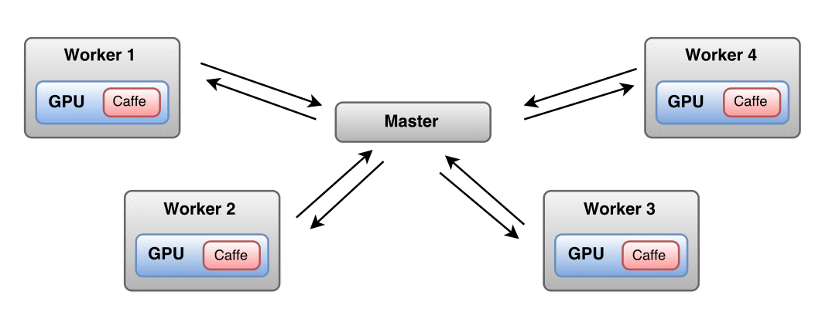
SparkNet
Released by AMPLab from 2015
Wrapper of Caffe and Tensorflow
Centralized parameter server
Strong SGD synchronization
Differentiating feature: A fixed number (τ) of iterations (mini-batch) on its subset of data
http://arxiv.org/pdf/1511.06051v4
Notes:
Now, let me introduce all frameworks one by one.
The first one is SparkNet. It released by AMPLab from 2015.
SparkNet doesn’t implement deep learning algorithm by itself but just wrap the model of Caffe and Tensorflow.
It uses centralized parameter server which runs in driver side.
SGD synchronization extent is strong which means that fetching and updating parameter are running in same thread with mini-batch.
There is a differentiating feature for SparkNet: each worker runs a fixed number τ of iterations on its subset of data.
It could enhance the weights changing effect of each SGD but cost more time.
User need to tradeoff between training effect and time consuming.

Slide 10
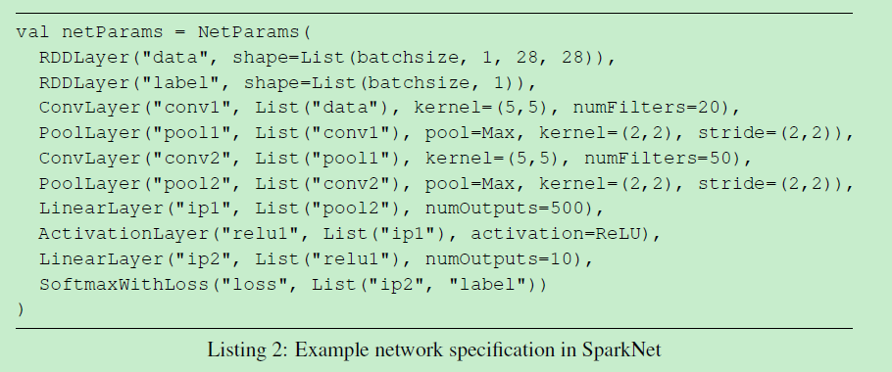
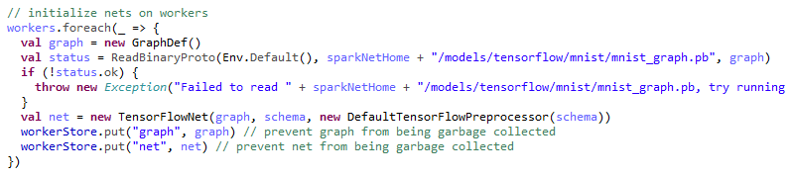



Evaluation Criteria | Dimensions | SparkNet | Score
Ease of Getting Started | Documentation | Paper; No Blog; README.md in Github
 | Installation | No Installation; Have to copy to each worker node
 | Built-in Examples | Cifar10/MNIST/ImageNet
Ease of Use | Interface | Java/Scala
 | Model Encapsulation | Model/Layer
Functionality | Built-in Models | Tensorflow and Caffe
 | Parallelism | Data Parallelism
Performance | Performance | MNIST
Status Quo | Community Vitality
 | Enterprise Support | AMPLab
 | 1 | 2 | 3 | 4
Iterations | 1000 | 2000 | 5000 | 10000
Time (seconds) | 2130 | 4218 | 10471 | 21003
Accuracy | 94.13% | 94.26% | 94.01% | 94.22%
Notes:
Let's fill out this table. Document, there is a paper to introduce how it implemented. No blog. All the installation and usage are on the README of Github but the README is relatively simple. If you submit a job according to the given statement, it will throw an out-of-memory exception. I run it successfully after modified akka frameSize and driver memory.
Installation, user don’t need to install. Just need to build a jar and copy code to each work node. There are some errors during build process. I suggest you disable test function before building jar file. Example, it has no too many examples, but have commons such as MNIST. Interface, java and scala, No SQL interface. Model Encapsulation, Model and Layer. [Click] At first let’s look at the usage of Model extent. The example here is to load a tensorflow’s model into SparkNet and then generate a data structure, named TensorFLowNet for training use. [Click] Next is an example of “Layer”. We can see that SparkNet has predefined several Layer API such as RDDLayer, ConvLayer(convolution) and PoolLayer. If you want to use Layer API, you have to fully understand the network topology of this algorithm and translate into your code. [Click] Built-in Models, all Caffe and Tensorflow’s model could be used in SparkNet. It will be wrapped into CaffeSolver or TensorFLowNet. This is a big advantage. But there is still a problem need to be mentioned. SparkNet now only support Tensorflow version zero point seven(0.7). I have tried Tensorflow zero point eight(0.8) but failed. Parallelism, data parallelism. As mentioned before, all deep learning on spark frameworks 'parallelism now are data parallelism. [Click] Next is performance, we used MNIST as the benchmark. Look at this table, I pick several points here. It can be seen that the relation between time and iteration is linear. The accuracy is up to upper bound before one thousand(1000) iterations. We will give benchmark comparison chart later. [Click] Community vitality, it is easy to quantify. There are almost four hundred(374) stars and 5 contributors. Obviously community is small but I think it’s still growing. Enterprise Support, there is no commercial version and so far most of support are from AMPLab. Here are my scores from a user and a developer point of views.

Slide 11
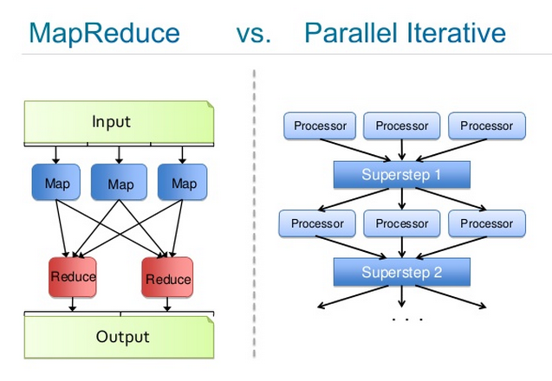
Deeplearning4J
Released by Skymind from 2014
An open-source, distributed deep-learning project in Java and Scala
Parameter server: IterativeReduce
Strong SGD synchronization
http://deeplearning4j.org/iterativereduce.html
Notes:
The second framework is deep learning 4j released by Skymind from 2014.
According to their own introduction, it is an open-source, distributed deep-learning project in Java and Scala.
It’s generic deep learning framework and can run on spark.
The computation model of DL4j is based on Map-Reduce but is an improved Map-Reduce: IterativeReduce.
It mitigates the disadvantages of map-reduce in the iterative computation.
It implements strong SGD synchronization.
Parameter synchronization and broadcast happen in reduce side.

Slide 12
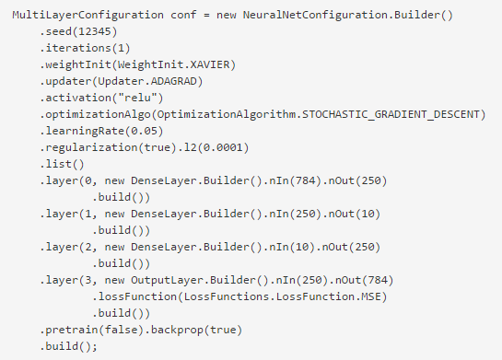



Deeplearning4J - Evaluation
Evaluation Criteria | Dimensions | DL4J | Score
Ease of Getting Started | Documentation | Comprehensive but bad-organized
 | Installation | No Installation
 | Built-in Examples | Only For CDH5;MNIST/IRIS/GravesLSTM
Ease of Use | Interface | Java/Scala
 | Model Encapsulation | Layer
Functionality | Built-in Models | CNN/RNN/LSTM/DBN/SAE
 | Parallelism | Data Parallelism
Performance | Performance | MNIST
Status Quo | Community Vitality
 | Enterprise Support | Skymind
 | 1 | 2 | 3 | 4 | 5 | 6 | 7
Epochs | 5 | 10 | 15 | 20 | 30 | 40 | 50
Time (seconds) | 2098 | 4205 | 6303 | 8367 | 12540 | 16711 | 21101
Accuracy | 70% | 79% | 82.7% | 84.6% | 86.4% | 87.8% | 88.7%
Notes:
Let’s fill out this table. Document, no paper, all materials are in official website. The document is comprehensive, detailed but not so well organized. For non-expert of deep learning, it will incur confusions. DL4j consists of many independent components such as nd4j,nd4s but the relationships between them are not very clear. It’s little bit confuse for me to determine which components is must be. Actually, DLj4 introduce itself in its document as comprehensive but complex.
Installation, need not to install and it provides pre-built version to run quickly. It’s so convenient here. Example, there are only three examples here and specify CDH5. I didn’t use cdh5. It could be run but still have some problems. For example, it cannot detect OpenBLAS even though I have installed it successfully. It affected the performance seriously.
Interface, Java scala and no SQL interface. [Click] Model Encapsulation, Layer. API is very well defined. User use it like this, define each network layer’s structure and set parameters. [Click] Built-in Model, it provided most of mainstream DNN model. Parallelism, data parallelism. [Click] Performance, when Epochs finished fifty(50) times, the accuracy reaches the upper bound eighty-eight point seven percent(88.7%) and cost more than twenty one thousand(21000) seconds. It’s really low efficiency compared with others. I need to mention here, the reason low efficiency may be caused by the OpenBLAS cannot be detected. [Click] Community vitality, very good. There are many contributors. Enterprise Support, it have commercial version and most of contribution comes from Skymind. [Click]

Slide 13
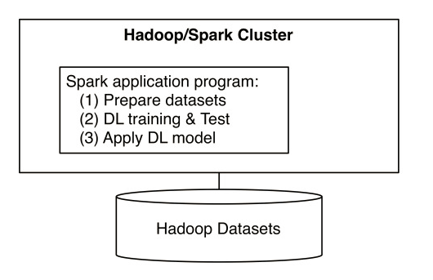
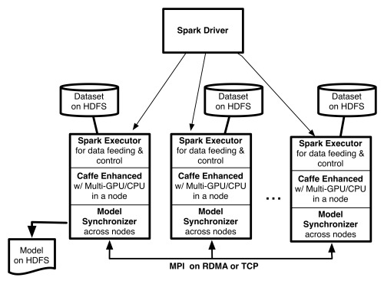
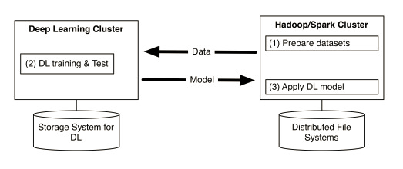
CaffeOnSpark
Released by Yahoo! from 2016
Peer-to-Peer parameter server
Strong SGD synchronization
Differentiating feature: MPI Allreduce, RMDA, Infiniband
Worker 1 (Parameter Server for w1)
w1
w2
w3
Weights propagation
(Gradients are sent in reverse direction)
Worker 3
(Parameter Server for w3)
Worker 2
(Parameter Server for w2)
w1
w2
w3
w1
w2
w3
Notes:
The third framework is CaffeOnSpark released by Yahoo! from this year.
There was also a talk about CaffeOnSpark given by Yahoo! in the first day of Spark Summit. According to their blog, they want to do this because they have a lot of business use deep learning include Flickr and Image Search. And they don’t want to build and maintain two clusters like this. So they want to integrate two into one like this.
The architecture of CaffeOnSpark is peer-to-peer, no dedicated parameter server, as shown in this figure.
The parameter server is not in driver side but is sharded by nodes in the cluster.
Parameter synchronization between nodes is by TCP or rmda.
This picture gives an introduction of parameter synchronization process.
There are three worker nodes. Each node holds one copy of parameters and is only responsible for updating and synchronizing their own parts to peers.
The arrow direction indicates weights propagation and reverse direction means send back the gradients.
The SGD synchronization extent is strong.
There is a differentiating feature for CaffeOnSpark: They use allreduce of MPI to synchronize parameter. And parameter synchronization between nodes support infiniband.

Slide 14
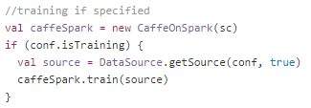



CaffeOnSpark - Evaluation
Evaluation Criteria | Dimensions | CaffeOnSpark | Score
Ease of Getting Started | Documentation | Blog; README.md in github
 | Installation | Have to install all Caffe needed in each node
 | Built-in Examples | Cifar10/MNIST
Ease of Use | Interface | Scala and Python
 | Model Encapsulation | Model
Functionality | Built-in Models | Caffe
 | Parallelism | Data Parallelism
Performance | Performance | MNIST
Status Quo | Community Vitality
 | Enterprise Support | Yahoo!
 | 1 | 2 | 3 | 4
Iterations | 1000 | 2000 | 5000 | 10000
Time(seconds) | 224 | 445 | 1113 | 2229
Accuracy | 97% | 99.4% | 99.7% | 99.6%
Notes:
Let's continue to fill out this table.
Document, there is a blog to introduce this project but no implementation details. All the installation and usage are on the README of Github and README is relatively detailed.
Installation, it’s inconvenient. User has to install all Caffe’s dependencies such as hdf5, boost even opencv which is an optional dependency.
Example, only Cifar10 and MNIST.
Interface, scala and python
[Click]
Model Encapsulation, model. User just needs to set Caffe model’s path in conf then you can start to train model. The encapsulation is very good. [Click]
Built-in Model, all Caffe supported, just CNN.
Parallelism, data parallelism
[Click]
Performance. Same as SparkNet, the relation between time and iteration is linear. The accuracy is up to upper bound between one thousand(1000)and two thousand(2000) iterations. [Click]
Community vitality, it’s not bad and between DL4j and SparkNet.
Enterprise Support, no commercial version and it supported by Yahoo!.

Slide 15
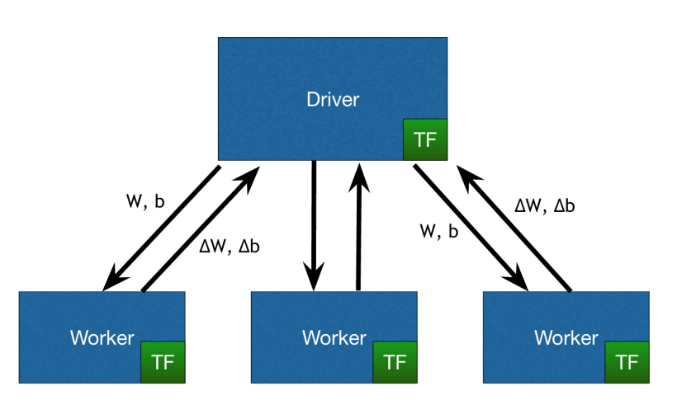
Tensorflow on Spark
Released by Arimo from 2015
A data-parallel Downpour SGD implementation on Spark
Centralized parameter server
Weak SGD synchronization
Notes:
The last one is Tensorflow on Spark released by Arimo from two thousand fifteen.
It’s a data-parallel downpourSGD implementation on Spark.
It is strictly followed the asynchronous SGD in Jeff Dean’s paper.
It used centralized parameter server and weak SGD synchronization.

Slide 16
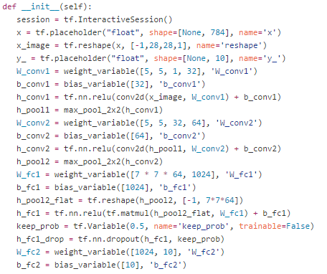



Tensorflow on Spark - Evaluation
Evaluation Criteria | Dimensions | Tensorflow on Spark | Score
Ease of Getting Started | Documentation | Blog; Spark Summit East 2016 slides and video
 | Installation | Dependent on Tensorflow and tornado
 | Built-in Examples | MNISTcnn/MNISTdnn
Ease of Use | Interface | Python
 | Model Encapsulation | Model/Layer
Functionality | Built-in Models | Tensorflow
 | Parallelism | Data Parallelism
Performance | Performance | MNIST
Status Quo | Community Vitality
 | Enterprise Support | Arimo
 | 1 | 2 | 3 | 4 | 5 | 6 | 7
Epochs | 5 | 10 | 15 | 20 | 30 | 40 | 50
Time(seconds) | 223 | 415 | 615 | 828 | 1255 | 1748 | 2619
Accuracy | 93% | 94% | 94.2% | 95.4% | 95.8% | 96.3% | 96.7%
Notes:
Continue to fill out this table, document, very simple, but have a blog, presentation slides and video of Spark Summit East.
Installation, easy. User only need to install tornado and Tensorflow.
Example, common examples only have MNIST. Interface, python and No SQL interface.
[Click]
Model Encapsulation, Model/Layer. Because Tensorflow on Spark is based on Tensorflow, so it can be seamlessly integrated with Tensorflow's model. If the user is familiar with Tensorflow, you can also use the Tensorflow’ API to generate the model. [Click]
Built-in Model, all Tensorflow supported model. Parallelism, data parallelism.
[Click] Performance, When Epochs finished fifty(50) times, the accuracy reaches the upper bound nighty six point seven percent(96.7%) and cost more than two thousand and six hundred (2619) seconds. There is one thing need to be noticed: the relation between time and iteration has been already not linear. The performance of this framework needs to be tested further.
[Click]
Community vitality, its community is still in early stage. Enterprise Support, it has commercial version and supported by Arimo.
[Today we just focused on these four frameworks. DeepDist and H2O sparkling water are not in today's content as DeepDist only support deep belief network and H2O sparkling water only provides high-level abstraction API; it’s not easy to implement a CNN model.]

Slide 17
Benchmark – MNIST
One master (16-Core,64GB) Five slaves (8-Core,32GB)
Executor memory: 20GB
Batch size: 64
Accuracy
Time (seconds)
Notes:
Let’s summarize the benchmark.
Our test environment is six machines cluster: One master and five slaves.
We set executor memory to twenty (20) GB and set train model batch size to sixty four(64).
Look at this chart, we can see except DL4J, the accuracy of other frameworks quickly reach to upper bound.
And all accuracy is greater than nighty percent (90%) except DL4J. The DL4J’s performance is much worse than other frameworks and accuracy upper bound is below nighty percent 90% [Click]

Slide 18
Benchmark – MNIST
One master (16-Core,64GB) Five slaves (8-Core,32GB)
Executor memory: 20GB
Batch size: 64
Accuracy
Time (seconds)
Notes:
In these slides let’s remove DL4J.
From this chart we can see that different framework have different accuracy upper bound.
For these three frameworks, CaffeOnSpark’s performance is best.
It can reach the accuracy upper bound more quickly and have higher upper bound.
The second is Tensorflow on Spark. We can observe the oscillation of accuracy from Tensorflow on Spark, which may be typical because of its asynchrony nature

Slide 19
Tensorflow On Spark - Evaluation
Evaluation Criteria | Dimensions | SparkNet | DL4J | CaffeOnSpark | Tensorflow on Spark
Ease of Getting Started | Documentation
 | Installation
 | Built-in Examples
Ease of Use | Interface
 | Model Encapsulation
Functionality | Built-in Models
 | Parallelism
Performance | Performance
Status Quo | Community Vitality
 | Enterprise Support
Easy of Use
Language:Java/Scala
Interface Level: Model/High Level Network Structure
Function
Algorithm:Excellent
Data Parallel
Only Ethernet
Easy to Get Start
Document: Average
Need to setup in each node
Example: Average
Performance
Maturity
Early Stage
Community: bad
Commercial or Big company support: AMPLab
Notes:
Here we gave a complete summary;
we summarize all scoring in one table.
As can be seen, each framework has its good part, and also has its shortcomings.
Like I said before, it’s from a user and a developer point of views and just for reference.

Slide 20
Conclusion
Common issues
Lack of model parallelism
Potential network congestion
Early-stage development
Future evaluation work
GPU integration
SGD synchronization
Parameter server architecture
Scalability
Notes:
Conclusion. For industry, there are a lot of thing needs to do.
The first one is model parallelism. We all know it’s difficult, but it should be done.
The second is potential network congestion. As the model is larger and larger and the introduction of GPU, the data exchange between each node will dramatically increase. How to solve the potential network congestion is crucial for the future of a framework.
The last one is development of each framework. Frankly speaking, now the entire deep learning on spark industry is in early-stage. There are a lot of things need to do to improve and perfect the framework.
From our side, following are our future evaluation work.
The first one is GPU related work.
We didn't do too many GPU related work. The main reason is that Spark does not support GPU directly and GPU is not databricks main focus. GPU is more suitable for distributed tensorflow.
The second one is SGD Synchronization. As mentioned before, different frameworks use different synchronization extent. But we still haven't made clear which is better. In the same way, we still don't know which architecture is better? Centralized or peer-to-peer, de-centralized. This two points are not easy to prove in theory(siri)(From a theoretical point of view).
We still need to find out a method to evaluate which is better.
The last one is scalability. About scalability, it’s crucial for cluster scale-out. We didn't do too much work here but we have found some frameworks have problem in this area.
That’s all we need to do next phase. Ok, that’s all, thank you.

